Slide 1

Design of plasma magnetic control MATLAB hands-on session
Adriano Mele adriano.mele@unitus.it
Notes:
Good morning everyone. Today I am going to report briefly on the experiments performed by the ASIPP and the CREATE teams at the EAST tokamak during the last 2019 experimental campaign on a model-based MIMO isoflux plasma shape controller.

Slide 2
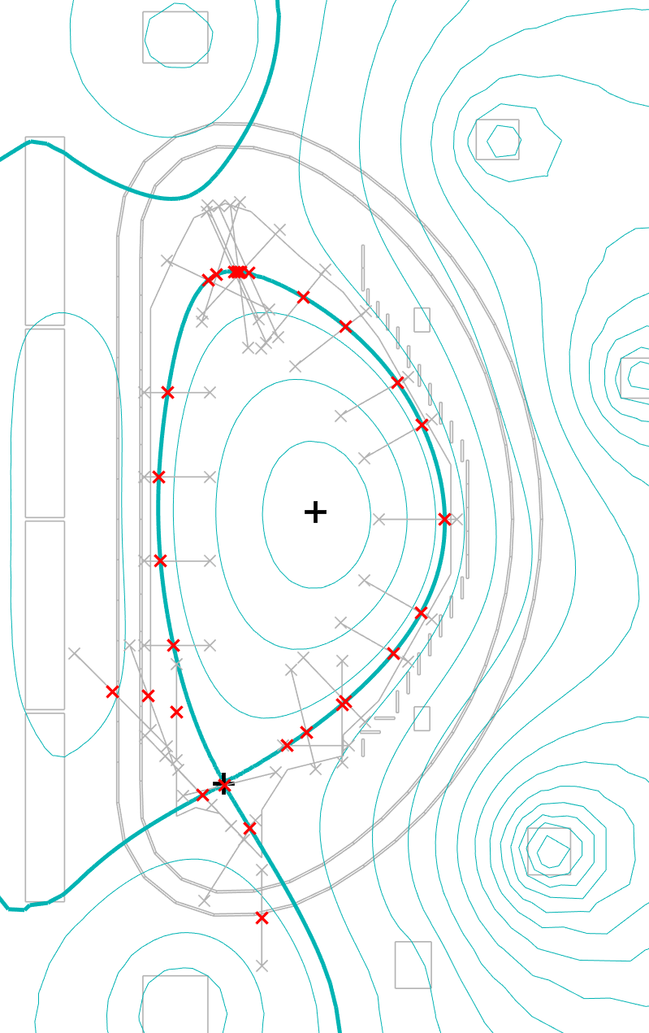
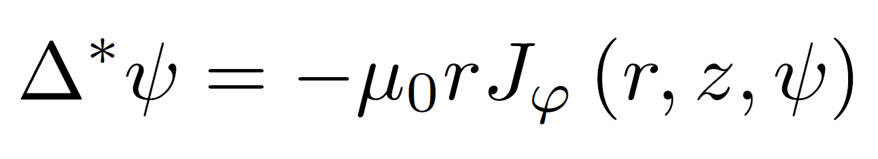
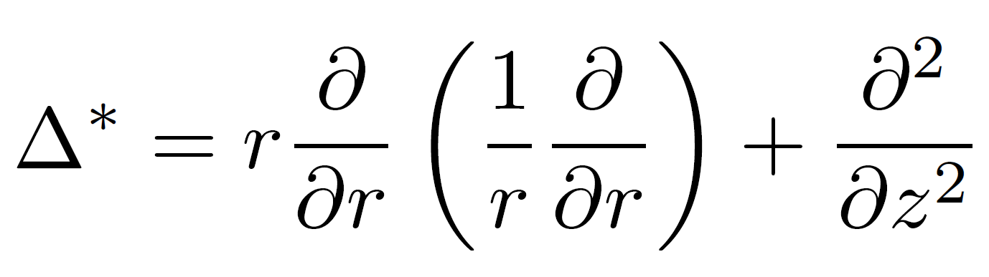
A quick recap: plasma equilibrium
Grad-Shafranov equation describes MHD equilibrium

Slide 3
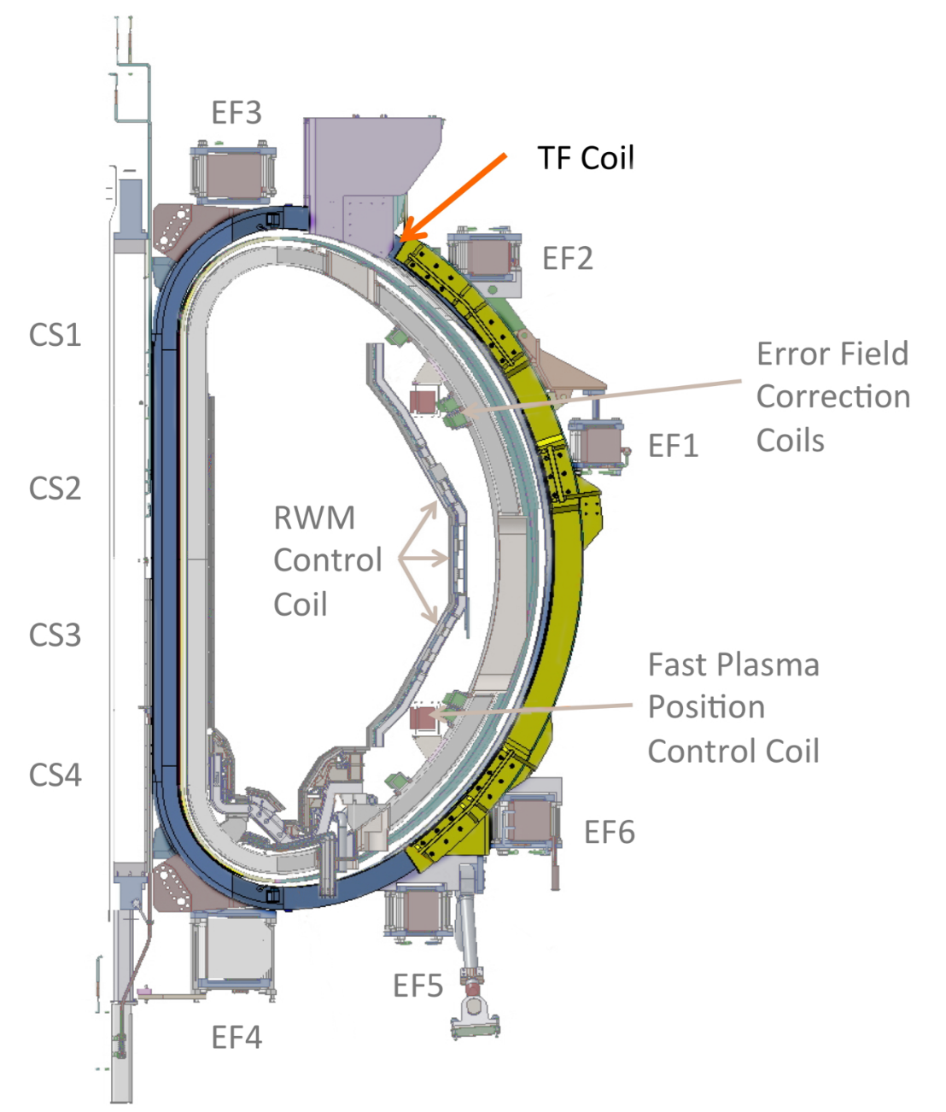
Tokamak Magnetic System
Toroidal Field Coils
Provide the strong toroidal field needed for magnetic confinement

Slide 4
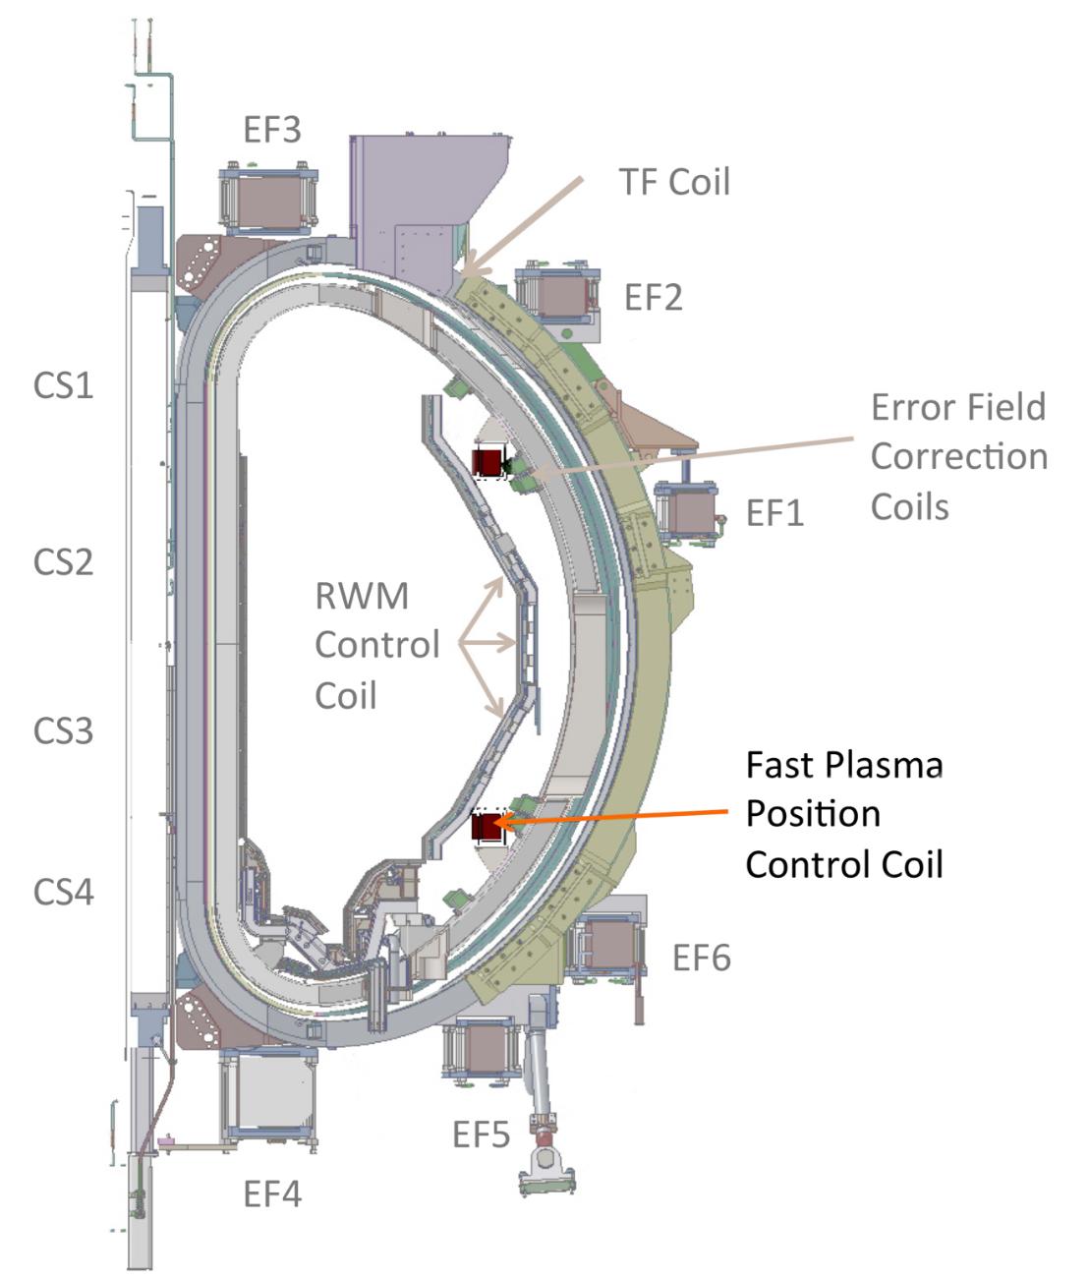
Tokamak Magnetic System
In-Vessel Coils
Dedicated to Vertical Stabilization

Slide 5
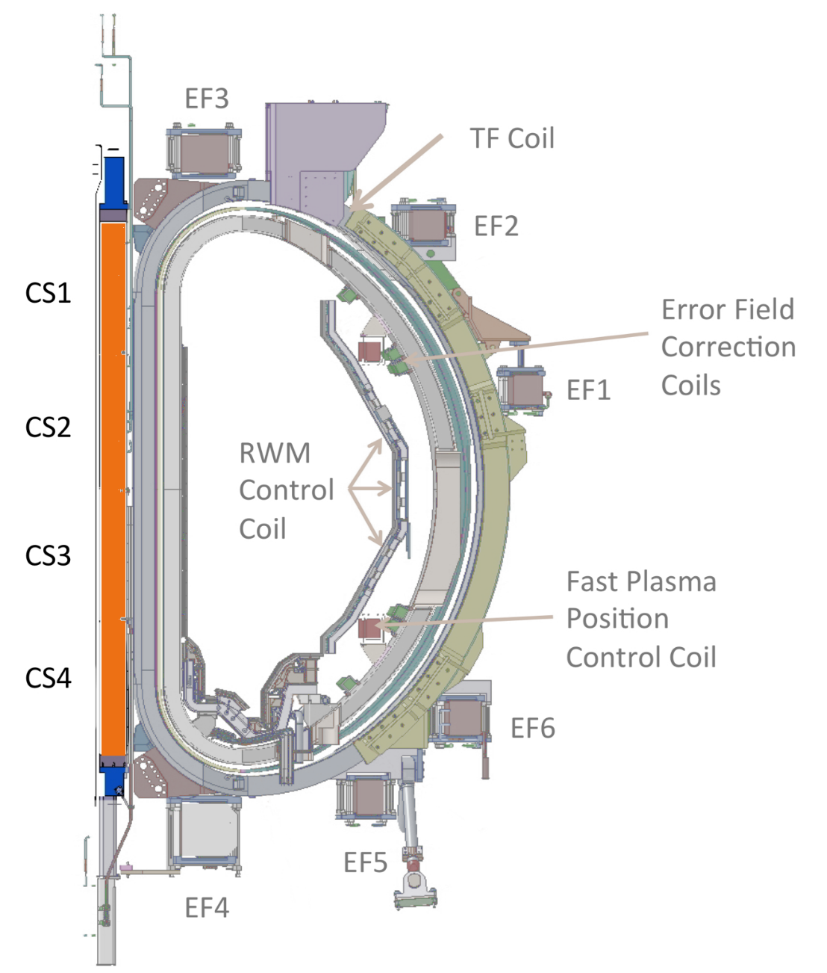
Tokamak Magnetic System
Central Solenoid
Mainly for plasma current control

Slide 6
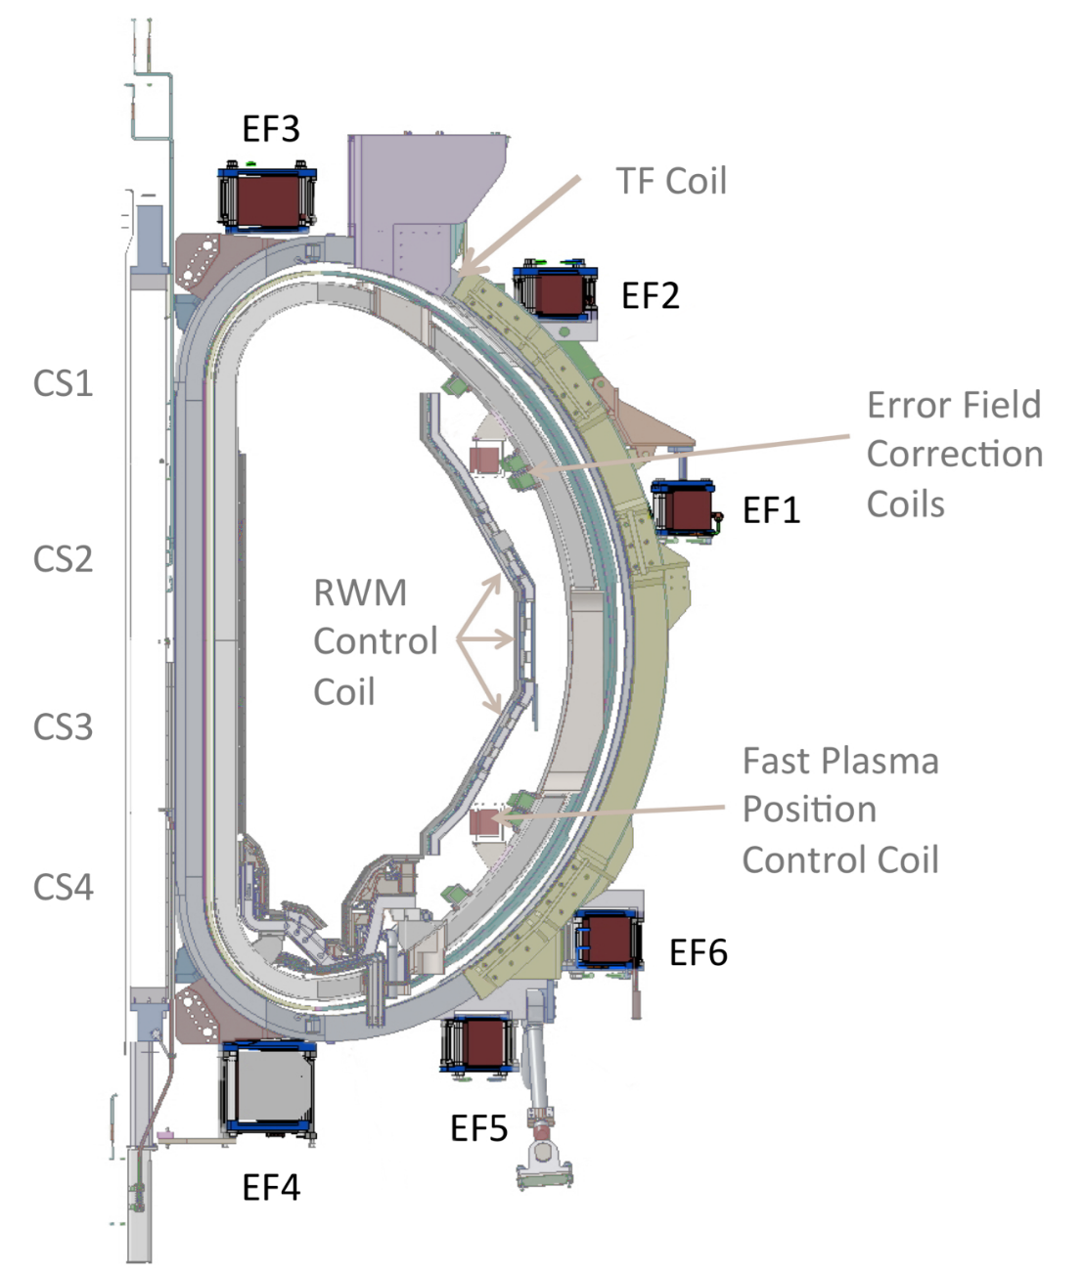
Tokamak Magnetic System
Poloidal/Equilibrium Field Coils
Mainly for position/shape control

Slide 7
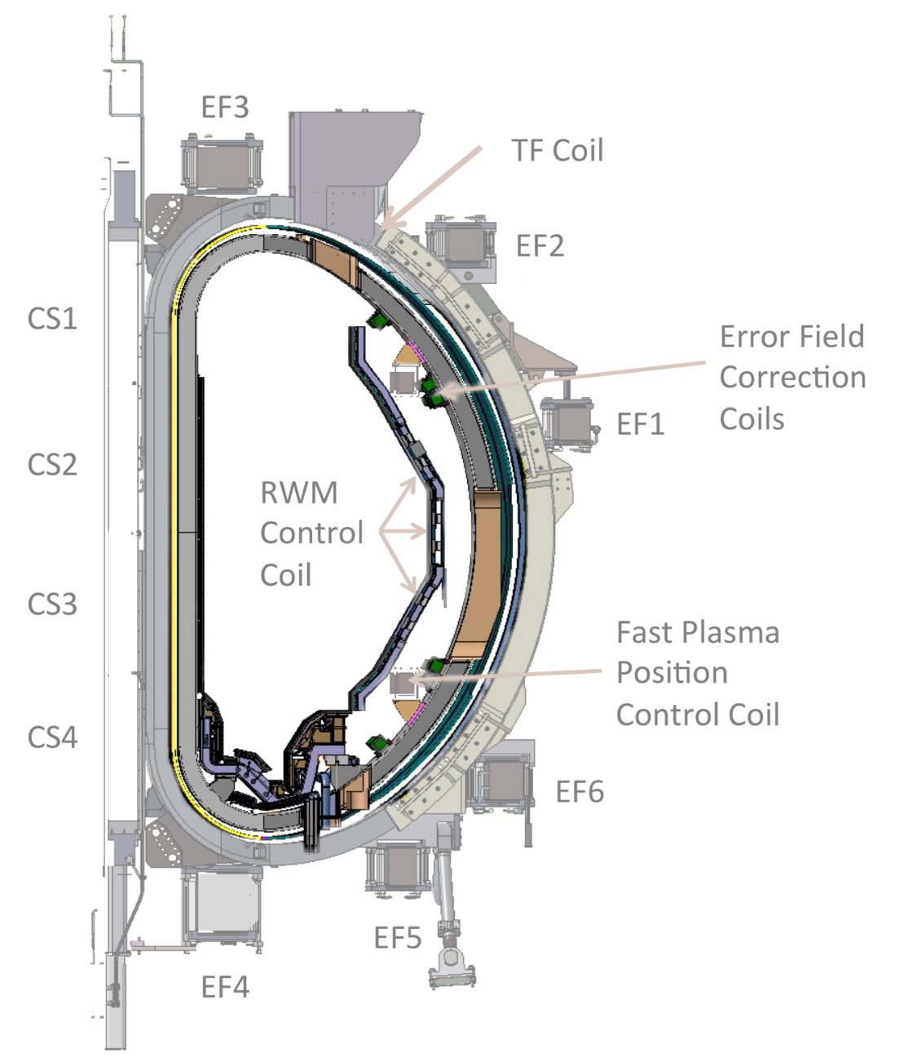
Tokamak Magnetic System
Passive structures
Improve plasma stability

Slide 8
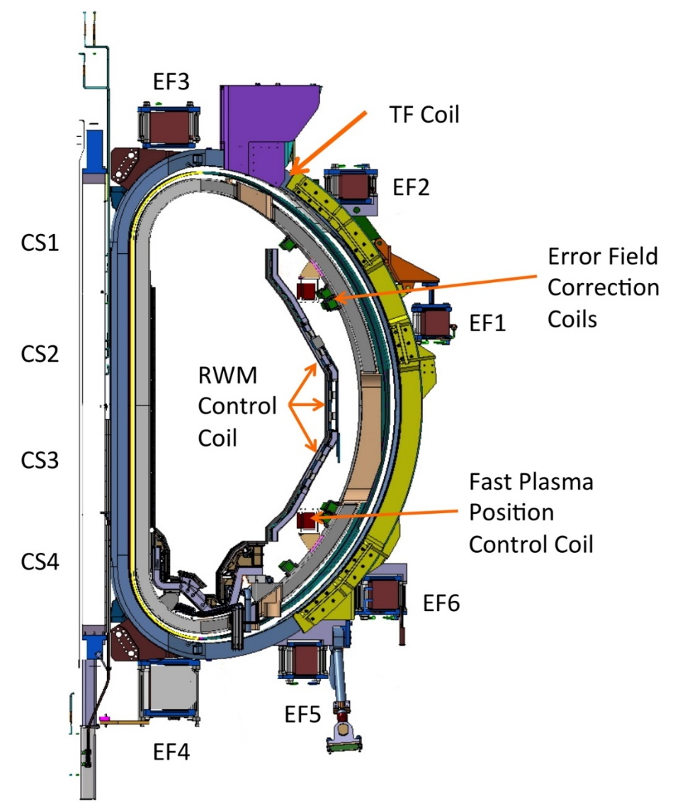
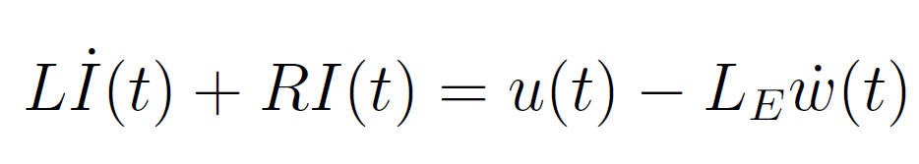
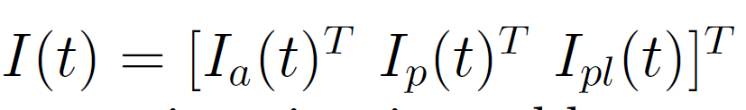
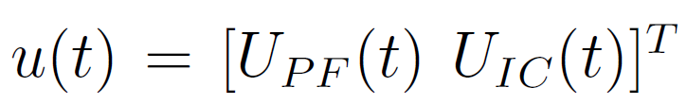
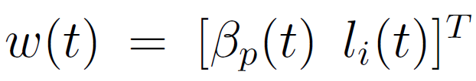
A quick recap: circuit equations
Plasma-coils coupling is described with a circuit model
Notes:
For the purpose of shape control, we couple the plasma mhd equilibrium seen before with the circuit equations that take into account the mutual induction between the plasma, the passive structures and the active coils.
The plasma is assumed to evolve quasi-statically through a series of equilibrium states, leaving the electrical dynamics as the dominant one. Once the reference equilibrium has been found (e.g. at a given time instant of a discharge), a linearized model can be computed around this configuration to synthetize the controllers. In our group, this procedure is usually carried out by means of two «in-house» codes called CREATE-L/NL.

Slide 9
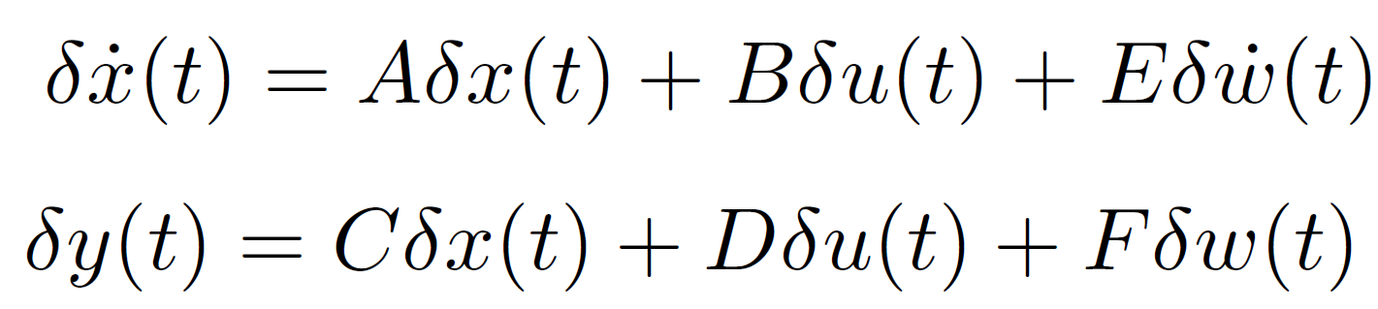
A quick recap: linearized model
Circuit equations can be re-cast in standard ISU form
Linearization carried out with CREATE-L/NL
R. Albanese, R. Ambrosino, and M. Mattei, “CREATE-NL+: A robust control-oriented free boundary dynamic plasma equilibrium solver,” Fus. Eng. Des., vol. 96-97, pp. 664–667, Oct. 2015.
Notes:
X: currents (active, passive, plasma)
u: applied voltages
W: plasma current profile parameterization (disturbances)
Y: outputs of interest, including geometrical descriptors

Slide 10
Magnetic control in tokamaks
Main goals:
Vertical stabilization of elongated plasmas
Poloidal Field Coils current control
Plasma current regulation
Plasma shape control
→ We’ll go through a full design step by step
M. Ariola and A. Pironti, Magnetic Control of Tokamak Plasmas, 2nd ed. Springer, 2016

Slide 11
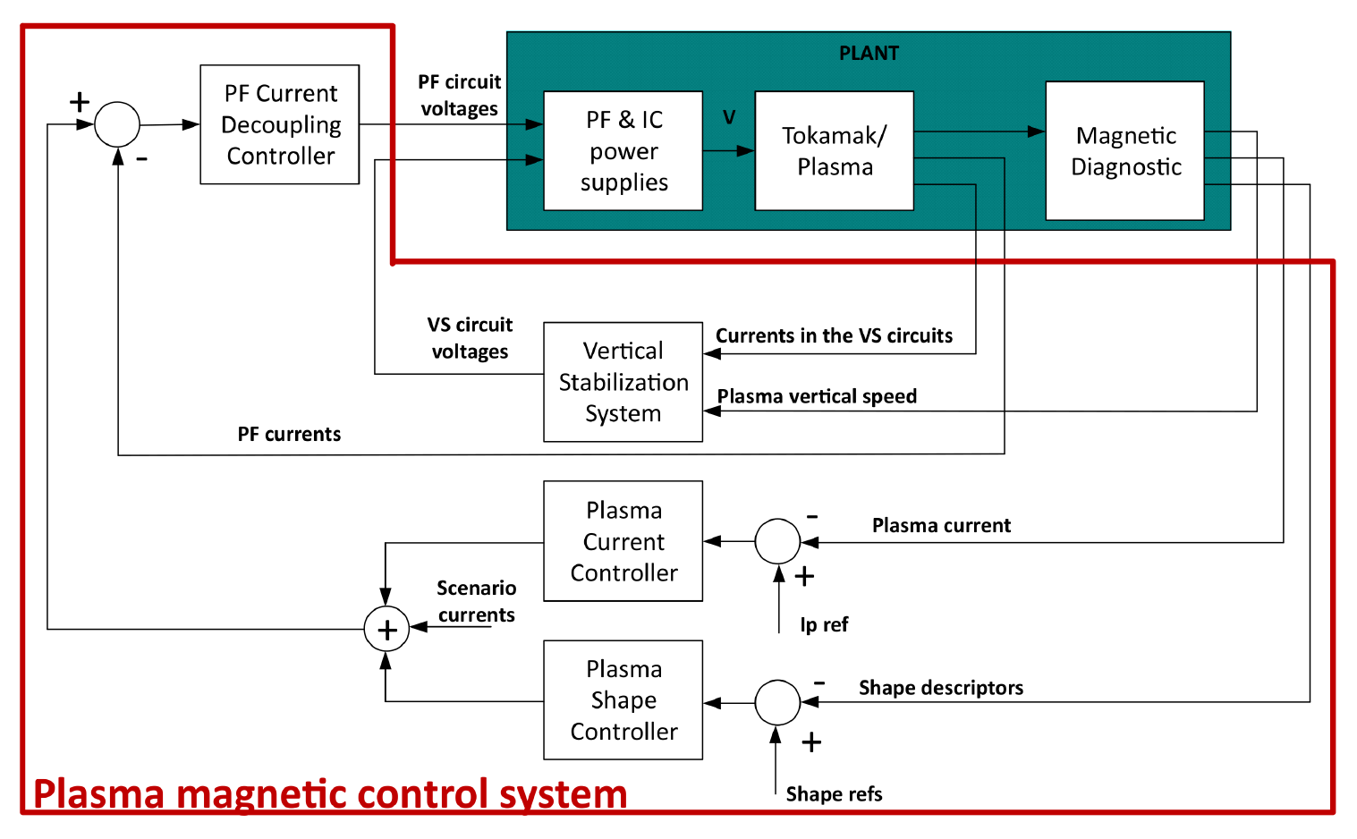
Magnetic control in tokamaks

Slide 12
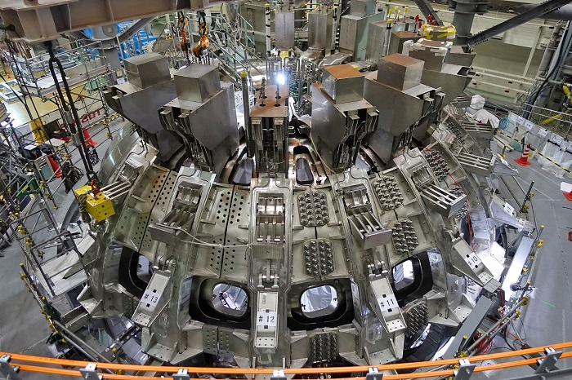
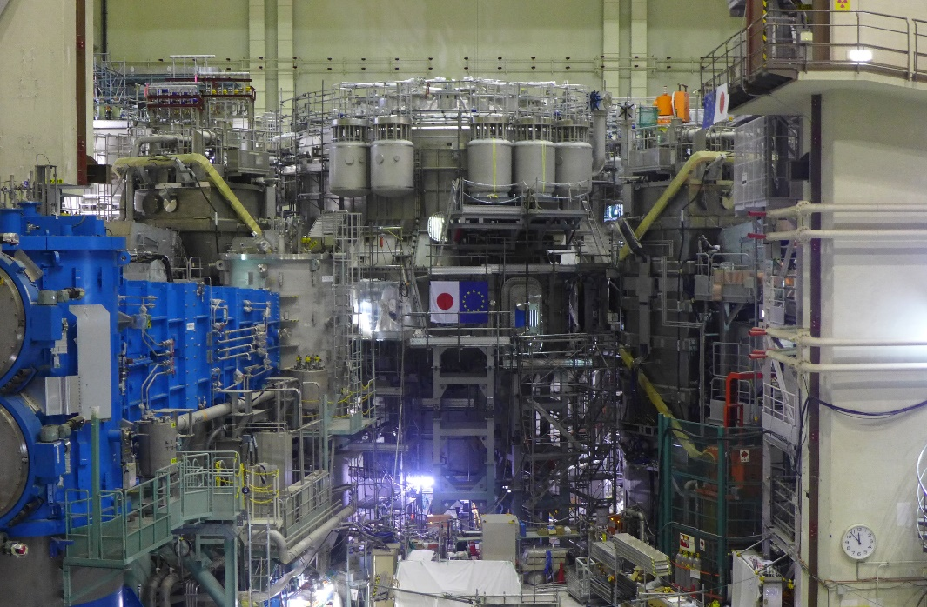
Our playground…

Slide 13
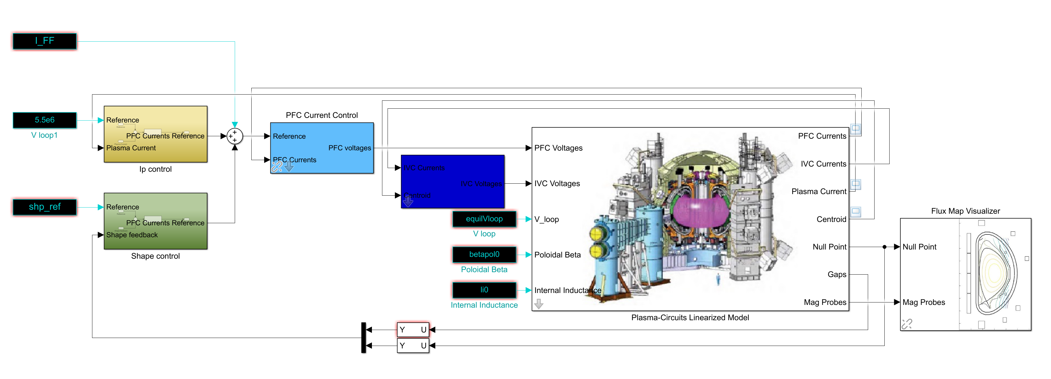
Our playground…

Slide 14
A final note
Magnetic control is only one aspect of control in tokamaks
There are other control systems which we’ll not take into account here
kinetic control: plasma temperature/density, q-profile…
«logic»/«industrial» control: plant supervision and coordination, safety systems, controlled shutdown, SCADA/HMIs…
auxiliary systems: gyrotrons, NBIs…
3D control: RWM, NTM suppression through ECRH, …

